Slide 1
Housing Prices Dataset
An initial 3-minute story about what seems to drive house prices
The question
Why are some houses much more expensive than others?
545
13
4.34M
13.30M
houses in the dataset
columns
median price
highest price
Initial story: price appears to rise with space, comfort features, and location access.
Notes:
This dataset contains 545 houses and 13 columns. The main question is simple: why are some houses much more expensive than others? The median price is 4.34 million, while the average is 4.77 million. Because the average is higher than the median, the dataset has some expensive houses pulling the average upward.

Slide 2
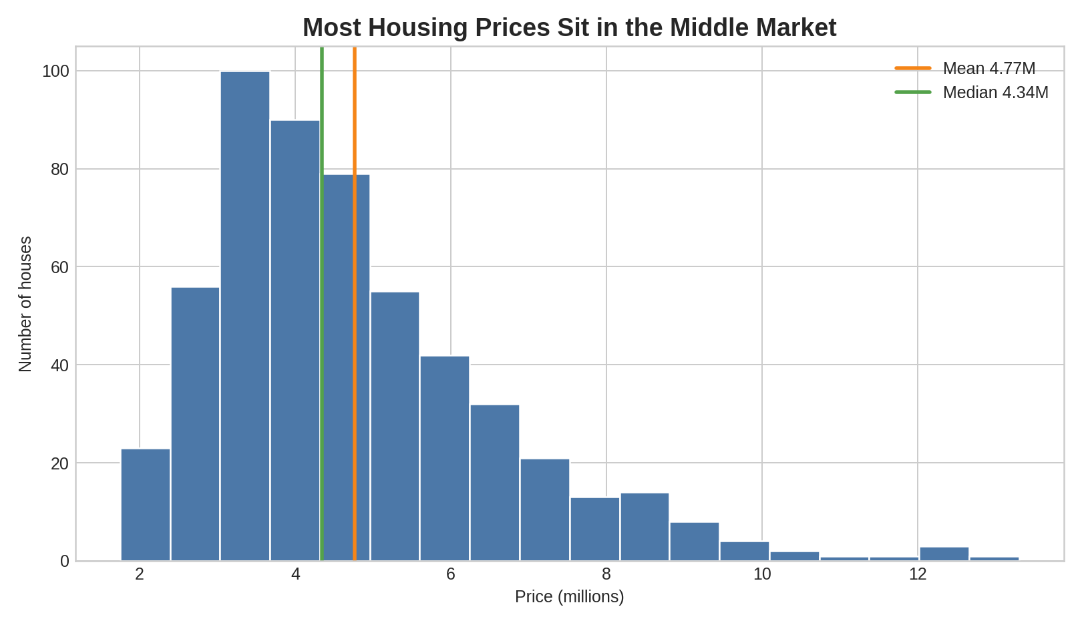
1. The market has a strong middle
Housing Prices Dataset | 2/5
What the distribution says
Most houses sit between about 3M and 6M.
The average price is higher than the median.
A smaller high-end group pulls the average upward.
Story point: start with the middle market, then explain what pushes some homes above it.
Notes:
Most houses are grouped around the middle price range. The histogram shows many homes between about 3 million and 6 million. A smaller number of high-priced houses sit above that range, reaching up to 13.30 million. This tells us the story is not only about the average price. We also need to understand what separates the high-end homes.

Slide 3
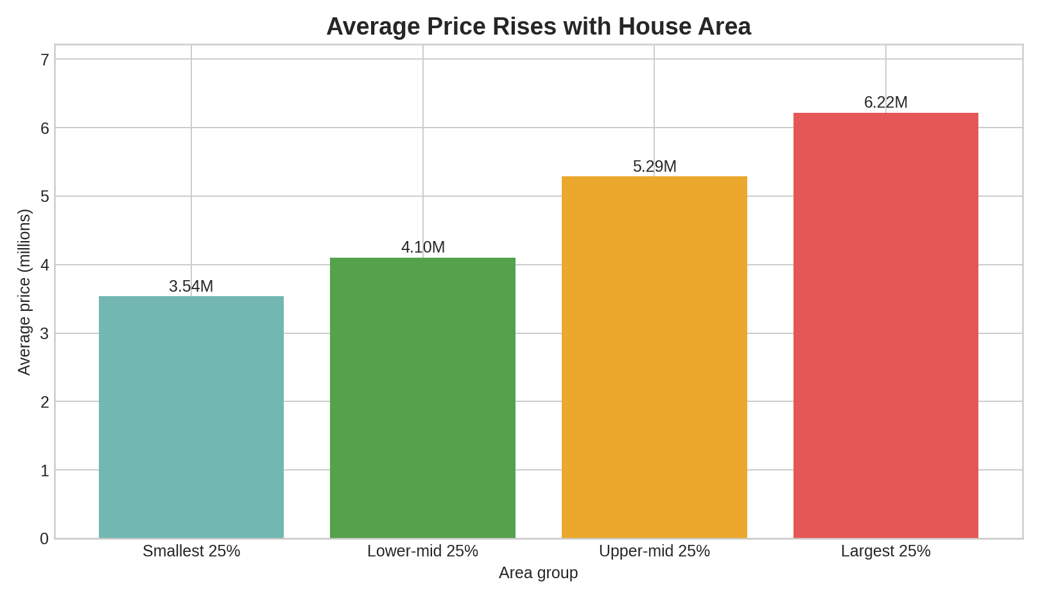
2. Size is the clearest price driver
Housing Prices Dataset | 3/5
Main evidence
Area has the strongest numeric relationship with price.
Average price rises from 3.54M to 6.22M across area groups.
Bigger homes are the easiest first explanation for higher prices.
Correlation with price: area 0.54, bathrooms 0.52, stories 0.42.
Notes:
The clearest numeric relationship is area. When the houses are split into four area groups, the average price rises from 3.54 million in the smallest group to 6.22 million in the largest group. This suggests that bigger homes are usually valued higher, and area should be one of the first variables to consider in any deeper analysis.

Slide 4
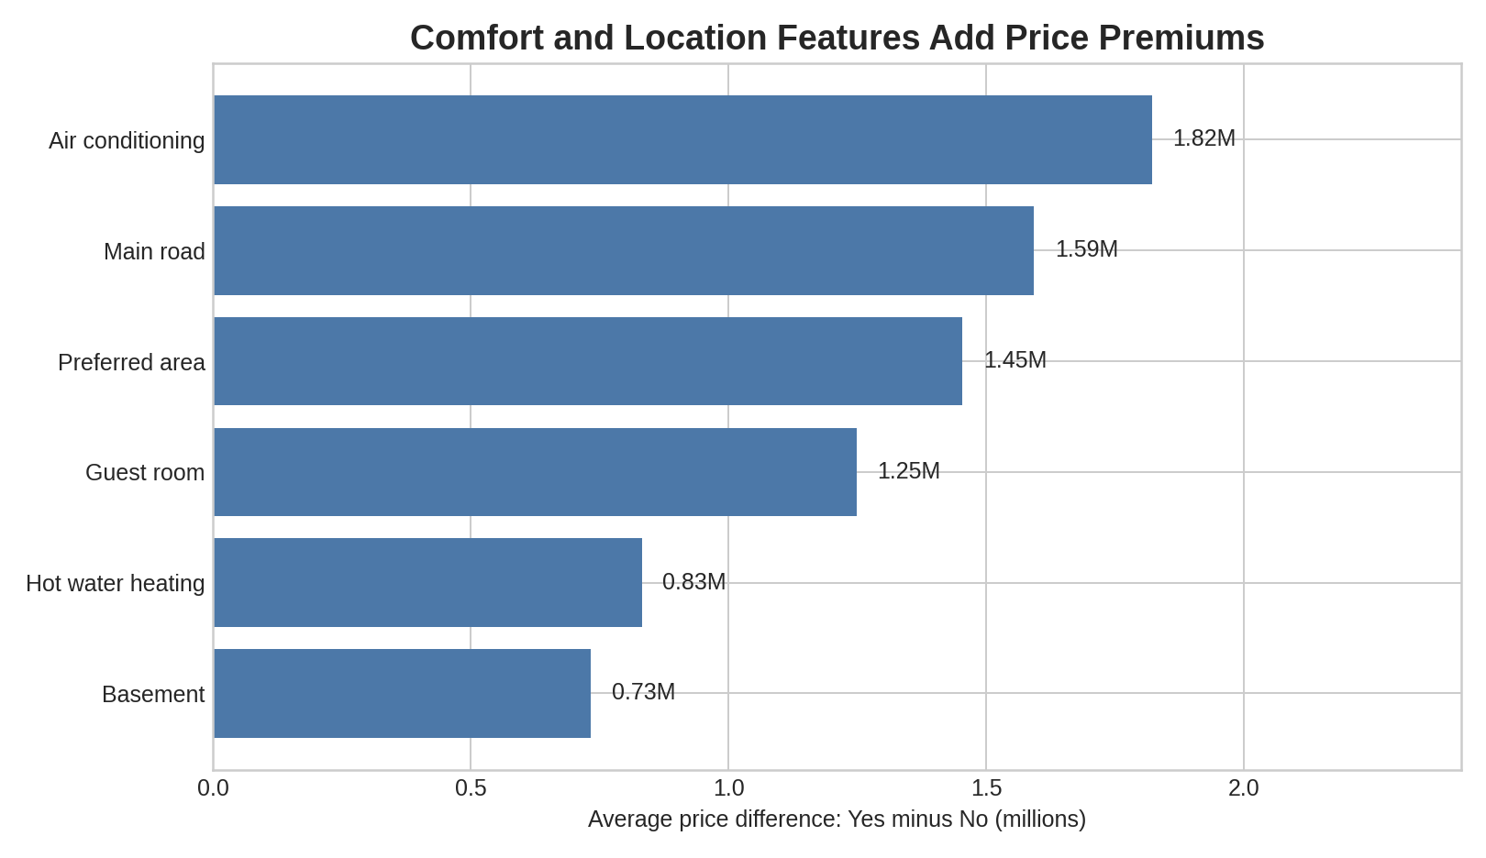
3. Comfort and access add premiums
Housing Prices Dataset | 4/5
Feature pattern
Air conditioning has the largest simple premium: about 1.82M.
Main road access and preferred area also show strong premiums.
These are descriptive patterns, not proof of causation.
Story point: buyers appear to pay more for practical comfort and easier access.
Notes:
Size is not the only part of the story. Houses with air conditioning, main road access, a preferred area, or a guest room have higher average prices than houses without those features. Air conditioning has the biggest simple difference, about 1.82 million. Main road access and preferred area are also strong. These are descriptive differences, so they show patterns, not guaranteed causes.

Slide 5
4. Initial story for discussion
Housing Prices Dataset | 5/5
Housing price looks like a mix of three ideas:
Space
Comfort
Access
Larger area is linked with higher average price.
Air conditioning and guest rooms lift the average price.
Main road and preferred area homes sell at higher averages.
Next step
Build a regression model to test these drivers together and separate real signal from overlapping effects.
Use this deck as an initial story, not a final model.
Notes:
The initial story is that housing price is shaped by three ideas: space, comfort, and location access. Larger houses tend to cost more. Comfort features make a house more attractive. Location features such as main road access and preferred area also lift the average price. The next step would be to build a regression model to test these drivers together and check which features still matter when the others are included.

